Slide 1
AAIDAN KA BAAS – Distt Sambhar
Rajasthan
Plantation Project - SPCHETNA

Slide 2
AAIDAN KA BAAS
Village details - village/location code 079576
Area - 3.56 km²
Population (2020) - 858
Population Density - 206 people per km²
- Male Population 455
- Female Population403
Nearest airport - Jaipur International Airport, 43.34 km
Nearest Railway Stn - Bheslana, 4.14 km

Slide 3
AAIDAN KA BAAS
Area in hectares - is 233.17 hectares.
Nearest town - Jobner 8km away
Tehsil - Sambhar
Distt. - Jaipur
The location Coordinates
- 26.956739515537286, 75.51924589450303

Slide 4
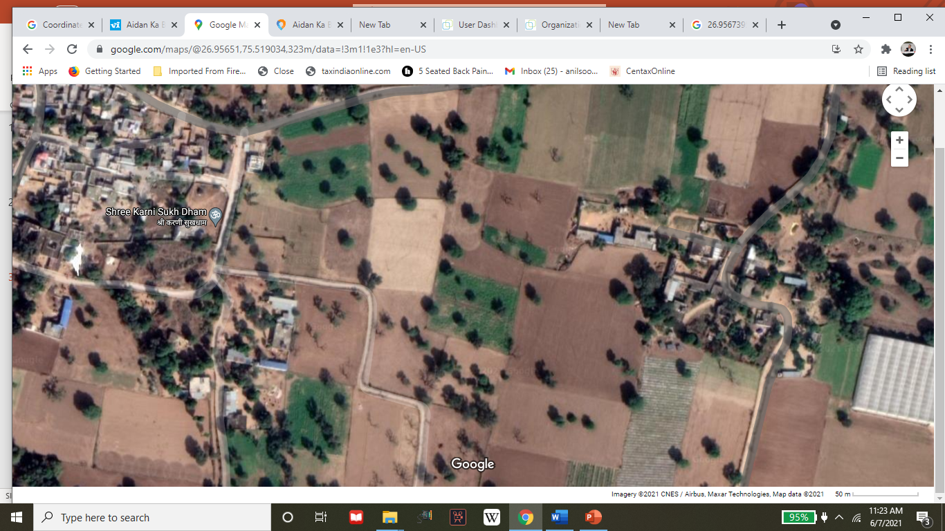
AAIDAN KA BAAS - Village Map

