Slide 1
INTRODUCTION
THE DENUDED FOREST HILLS
ON JAIPUR DELHI NATIONAL HIGHWAY

Slide 2
RE-AFFORESTING Proposal for Climate Change
During few visits to Jaipur to forest areas observed some high hills along the National Highway no.8, few high hills of forest along the highway lying barren and almost devoid of vegetation.
A GREEN BELT along the National Highway can reduce the air and noise pollution, whereas these barren hills are posing the disastrous look elevating the pollution along the road.

Slide 3
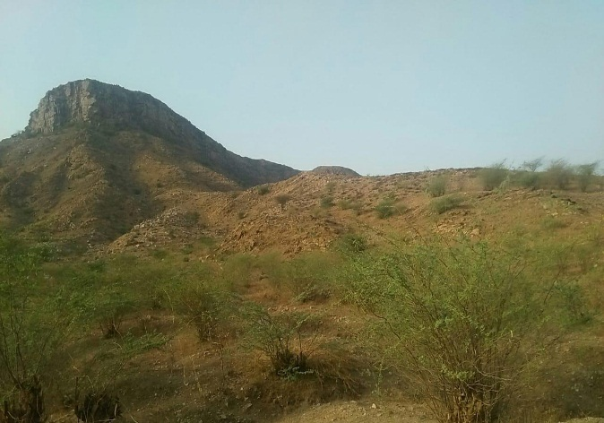
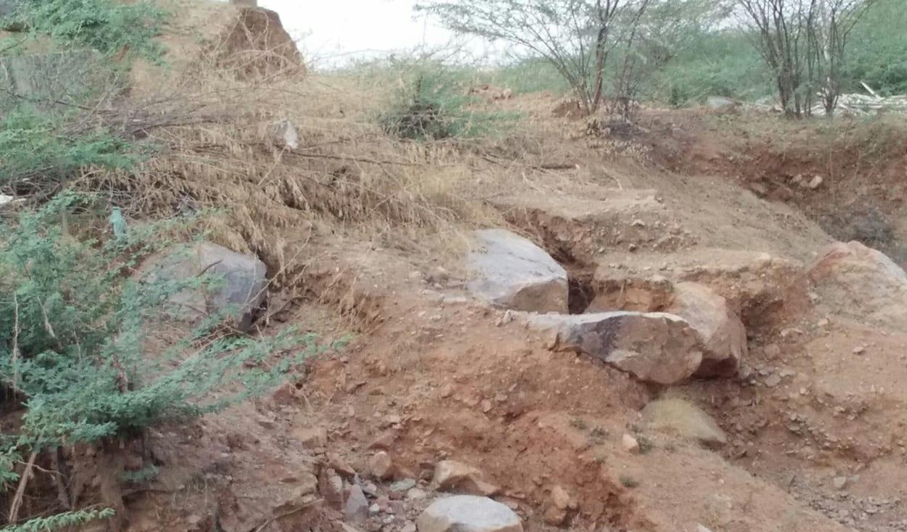
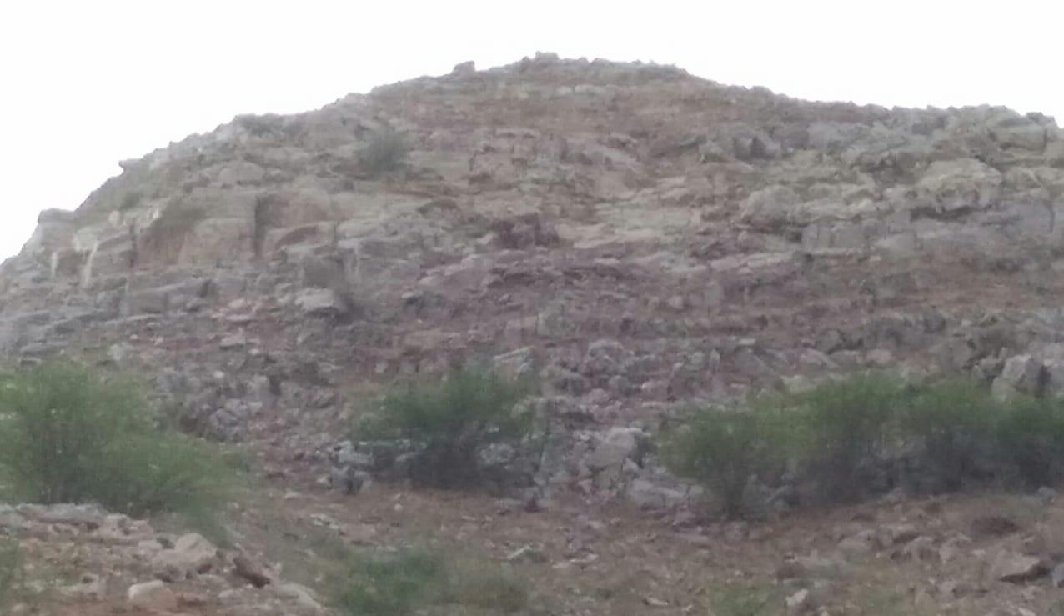
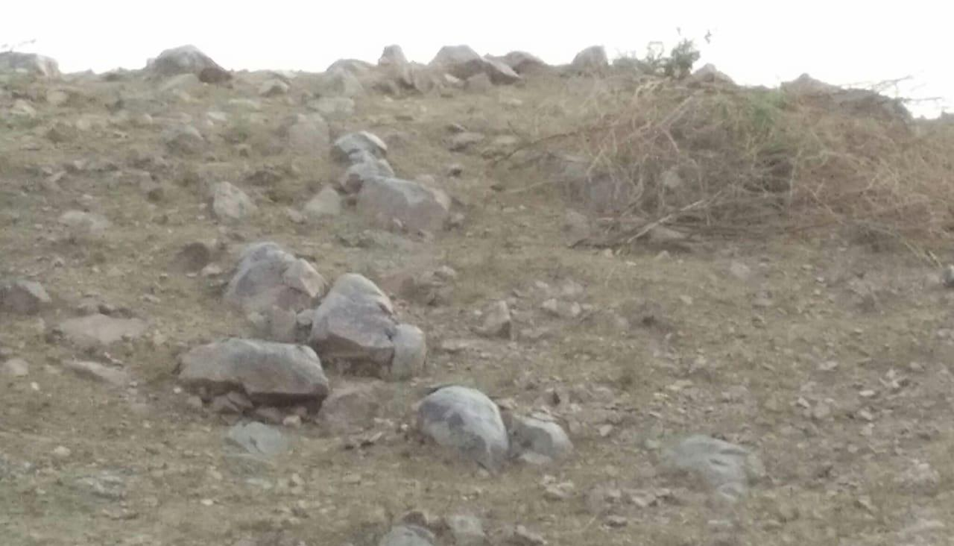
PROPOSED LOCATION
It is therefore
proposed to bring to the knowledge of concerned authorities
so that an immediate action may be started to reforest these hills so that they may be vegetated again improving the habitat for wildlife also in near future. It can be very good effort in bringing a remarkable change in the local climate and environment.

Slide 4
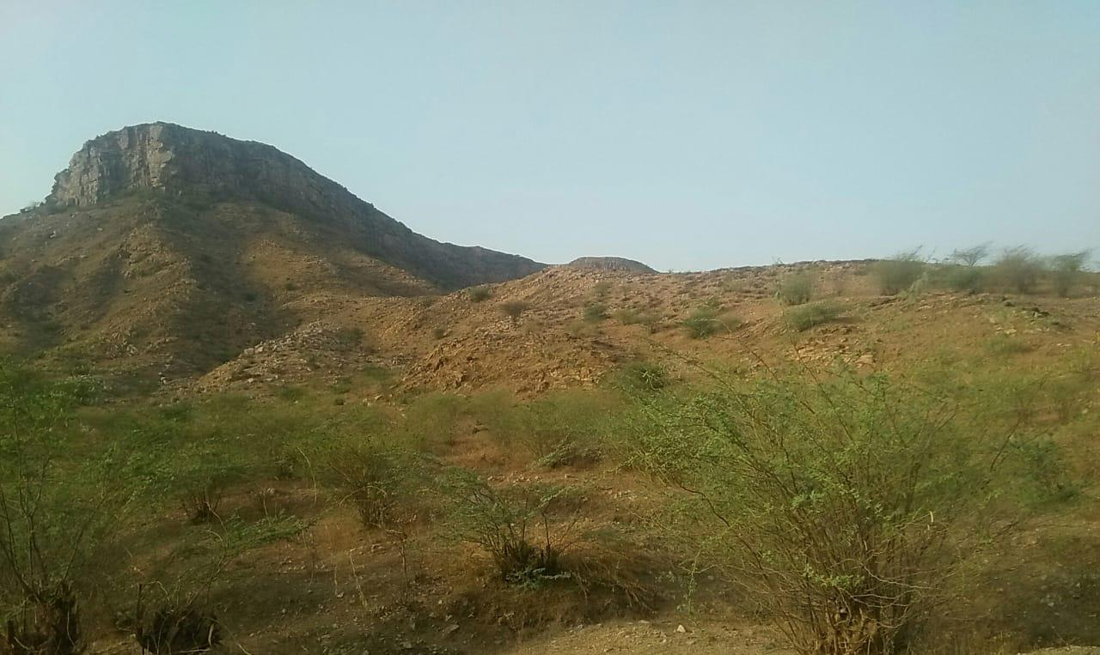
PROPOSAL
It is therefore proposed to bring to the knowledge of concerned authorities
so that an immediate action may be started to reforest these hills so that they may be vegetated again improving the habitat for wildlife also in near future. It can be very good effort in bringing a remarkable change in the local climate and environment.

Slide 5
OBJECTIVES
Protection of the area with fencing
Plant flower bearing local species on the hill slopes
Stop soil erosion by appropriate technical measures
Trap and Conserve rain water to improve soil moisture
Replanting local and Aravalli flora species in the area species of medicinal importance and grasses of best fodder value.
Involve local people and NGO’S in forest management
Develop
water sources for wild life.

Slide 6
CLIMATE CHANGE
Use of Renewal energy
Improving personal habits
Reducing Carbon Footprints
Lives in the natural Climate
Reforesting the barren lands and hills by local species of plants can bring a great change in the climate in course of time. Following activities may be considered in this aspect:
Using and advertising the use of energy–efficient equipment's e.g. solar energy system.
Use of renewable energy: Adopting solar panels or a wind turbine, to be a part of the clean-energy economy. People’s awareness programs in this regard may be taken up
Live in the natural climate: Home heating and cooling is the biggest residential demand on our energy system .We should switch over to live with the local natural climate by adopting the olden days practice. This will indirectly motivate people to grow more trees.
Reducing Carbon Footprints: Buying local and seasonal food products will reduce energy use in transport and storage. Buying items needing minimal packaging will also reduce use of resources.
Improving personal habits: Reducing the amount of sugar, salt, fat and processed food in diet, Exercising for at least half an hour on most days of the week, non-smoking, reducing alcohol intake, plenty of sleep will keep us fit and healthy and hence the healthy brain which will reduce anxieties and depression. Awareness programs in this area may be conducted to motivate people.

Slide 7
ACTIVITIES PROPOSED
1. Protection measures
2. Soil and moisture conservation activities
3. Awareness programs
4. Treatment of the hill slopes and rocky areas
5. Plantation and herbal grooves
6. Water harvesting and its use to bring climate change.
7. People’s participation
1. Protection measures
2. Soil and moisture conservation activities
3. Awareness programs
4. Treatment of the hill slopes and rocky areas
5. Plantation and herbal grooves
6. Water harvesting and its use to bring climate change.
7. People’s participation

Slide 8
BENEFITS:
Green mass will be increased.
Natural habitat will be improved for wild life.
Rain water will be harvested which will improve the water level of the local area.
Medicinal herbs will be restored and hence local people may get benefitted using it in Ayurvedic treatment.
Barren forest hill will restore Greenery.
The flower bearing species will add to the aesthetic value of the hill and make the journey of the tourists along the highway soothing.
Employment will be provided to the local people.
Motivation will help local people grow more trees on their own farmlands and village community lands.
Forest friendly people may come forward and help the cause of forest and environment conservation.
Oxygen replenishment will be enhanced and carbon dioxide reduction will take place.
Benefits of Project implementation

Slide 9
FINANCIAL IMPLECATION
S.No | Particulars | Amount (In Lac Rupees)
1. | Closing of the area by appropriate mode of fencing to ensure protection against grazing and making patrol paths etc. | 150.00
2. | Control of soil erosion and making green vegetative contour line bunds and existing vegetation improvement | 50.00
3. | Awareness program | 09.00
4. | Making approximate 1.50 lac pits etc for planting | 50.00
5. | Planting of saplings including cost of saplings and their maintenance for 5 years | 225.00
6. | Rain water harvesting and channelizing it to water reservoirs and then using for irrigation of the saplings | 100.00
7. | Watch and ward | 16.00
8 | Publicity and extension activities | 15.00
9 | Administrative and consultation expenses | 15.00
10. | Contingencies | 05.00
 | Total | 635.00

Slide 10
Questions

